Slide 1
Javascript development frameworks
Angular services

Slide 2
Course objectives
Introduction to Javascript. Overview
Basic http handling
Building a web server with NodeJS
NodeJS. Request and response, HTML templates, JSON data
NodeJS routing
ExpressJS
NPM, build tools
File management. Promises
Introduction to TypeScript
Introduction to Angular 5
Angular modules, applications, components
Angular services
Angular templates
Observables in Angular
Routing in Angular

Slide 3
Learning objectives
Template directives (ngIf, ngFor)
Creating services
Dependency injection
Lifecycle hooks

Slide 4
Template directives (ngIf, ngFor)
Structural directives are special kind of components that change the structure of the element
* - indicates template directive

Slide 5
Template directives (ngIf, ngFor)
ngIf is a structural directive that displays the element only if the expression is true
<md-list>
<md-list-item *ngIf=“contact.age > 18”>
…
</md-list-item>
<md-list>

Slide 6
Template directives (ngIf, ngFor)
ngFor directive instantiates a template once per item from an iterable
items – expression evaluating a collection
let item – Local variable for each iterator
items = [{},{},…];
<md-list-item *ngFor="let item of items">
...
</md-list-item>

Slide 7
Services
We can create services using ES2015 classes
import { Injectable } from '@angular/core';
@Injectable()
export class ContactsService {
private contacts: Contact[] = CONTACTS;
getContacts() {
return this.contacts;
}
}

Slide 8
Services
Dependency
Token
Instructuion
Injector
Provider
Object

Slide 9
Configuring the injector
An NgModule providers property accepts a list of providers to configure the injector
@NgModule({
...
providers: [
{ provide: ContactsService, useClass: ContactsService }
]
})
export class ContactsModule {}

Slide 10
Configuring the injector
An NgModule providers property accepts a list of providers to configure the injector
@NgModule({
...
providers: [
ContactsService
]
})
export class ContactsModule {}

Slide 11
Injecting dependencies
Dependencies can be injected using TypeScript type annotations
@Component(...)
export class ContactsAppComponent {
contacts: Contact[];
constructor(contactsService: ContactsService) { this.contacts = contactsService.getContacts(); }
}

Slide 12
Injecting dependencies
We use the token (or type) to ask for a dependency instance
But a provider defines what and how an object is being created for that token (or type)

Slide 13
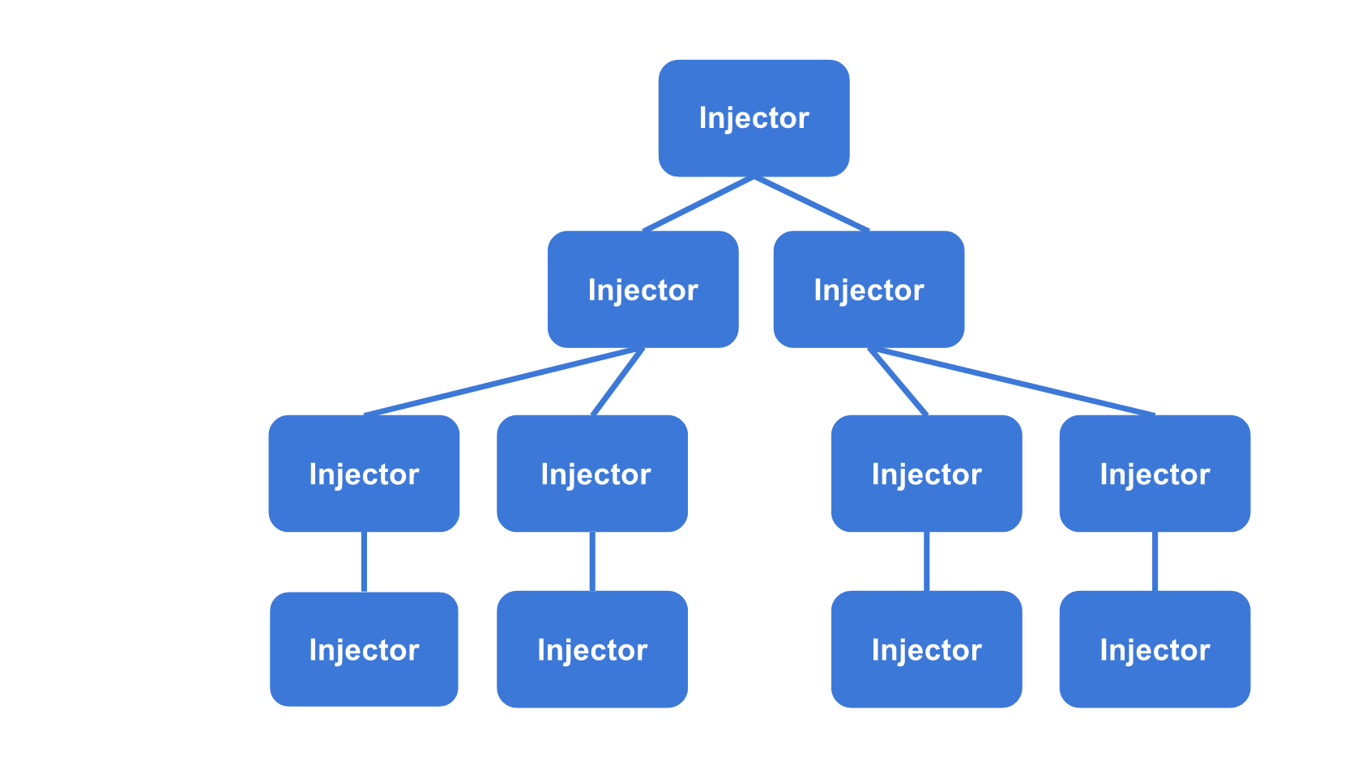
Injecting dependencies

Slide 14
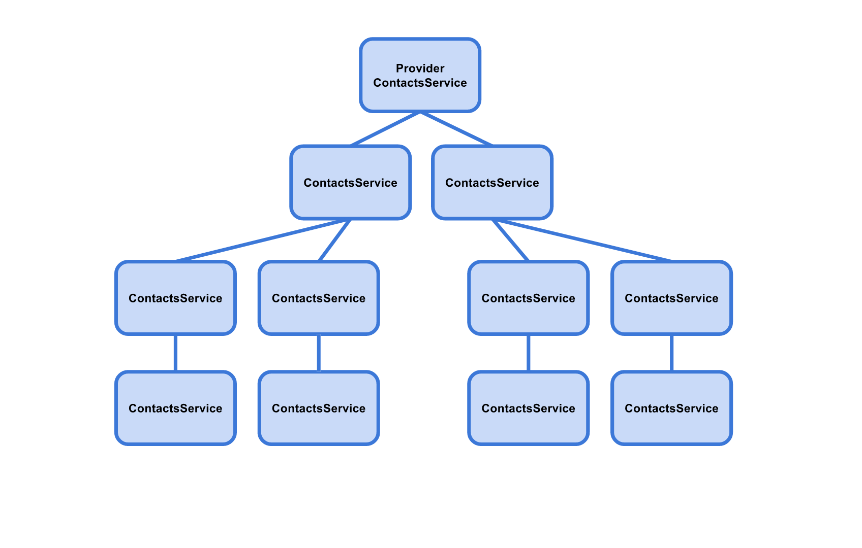
Injecting dependencies

Slide 15
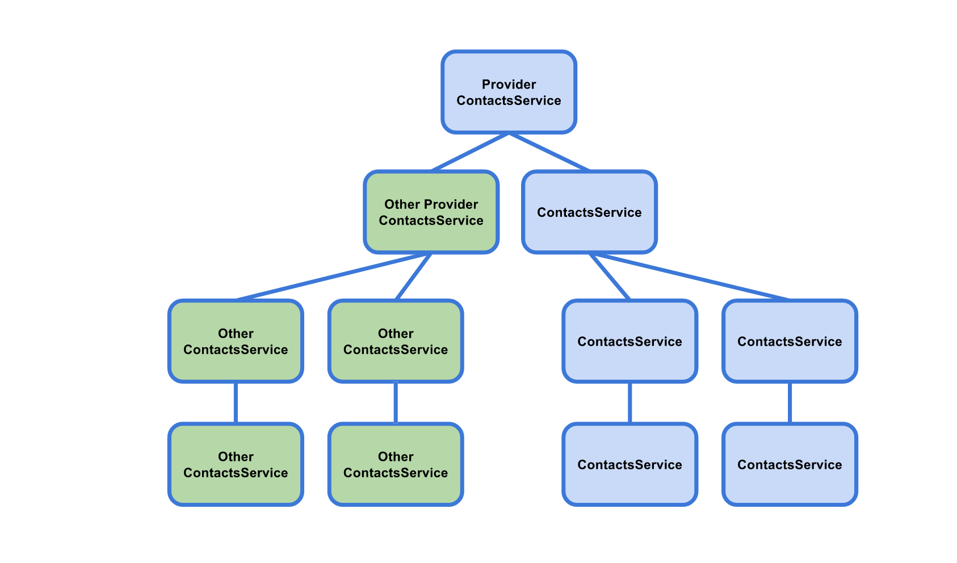
Injecting dependencies

Slide 16
Lifecycle hooks
Dependencies and Components have lifecycle hooks. Some of them are:
ngOnInit – initializes the directive
ngOnChanges – Respond after Angular sets data-bound property
ngDoCheck – Custom change detection
ngOnDestroy – Cleanup after Angular destroys directive

Slide 17
Lifecycle hooks
import { OnInit } from '@angular/core';
...
export class ContactsAppComponent implements OnInit {
contacts: Contact[];
constructor(private contactsService: ContactsService) {}
ngOnInit() {
this.contacts = this.contactsService.getContacts();
}
}

Slide 18
Demo

Slide 19
Tasks

